Slide 1
Eating Fish
Maximizing Benefits &
Minimizing Risks
Kenneth D. Rosenman, M.D.
Professor of Medicine
Michigan State University
Funding - Great Lakes Restoration Initiative EPA GL-00E00461
No commercial conflicts of interest
Notes:
EPA has provided funding to educate health care professionals as part of the Great Lakes Restoration Initiative. Most funds for this initiative are being used for environmental assessment and cleanup but it will be years before those cleanups reduce contaminant levels in fish. In the meantime, what do we advise our patients (not to mention our families and ourselves). Eating fish has benefits, which we want to maximize, while at the same time we want to minimize any adverse effects from pollutants which contaminate the fish.

Slide 2
Objectives
Benefits of Eating Fish/Fish oil
Risks of Eating Fish/Fish oil
Store Bought vs. Recreational Caught Fish
Talking to Patients
Available Resources
Notes:
Here are objectives of today’s presentation – Overall we want to encourage patients to eat fish but not all types of fish. – As stated in the title, Maximize benefits and Minimize risks from pollutants in fish.
The issues of fish oil vs. fish and wild vs. farm will be addressed since these are commonly asked questions.
Finally, this presentation will address how we translate all this information into something we can use in a patient encounter in our offices.

Slide 3
AHA 2006 Diet and Lifestyle Recommendations for Cardiovascular Disease Risk Reduction
• Balance calorie intake and physical activity to achieve or maintain a healthy body weight.
• Consume a diet rich in vegetables and fruits.
• Choose whole-grain, high-fiber foods.
• Consume fish, especially oily fish, at least twice a week.
• Limit your intake of saturated fat to <7% of energy, trans fat to <1% of energy and cholesterol to <300 mg per day.
• Minimize your intake of beverages and foods with added sugars.
• Choose and prepare foods with little or no salt.
• If you consume alcohol, do so in moderation.
• When you eat food that is prepared outside of the home, follow the AHA Diet and Lifestyle Recommendations. (Circulation 2006; 114:82-96)
Notes:
I will first talk about the benefits for heart disease where the data is stronger than gestational benefits. In 2006, the American Heart Association published recommendations for reducing CV disease risks. This presentation is only about the recommendation to eat two oily fish servings per week. I will define what “oily fish” are shortly.
As early as 1944, Eskimos in Greenland, whose diet was high in saturated fats and low in fruits and vegetables, were noted to have a low prevalence of heart disease.

Slide 4
Major Classes of Fatty Acids
FAMILY | FATTY ACIDS | FORMULA | SOURCE
Omega-9 | Oleic acid | C18:1 | Most vegetable oils (canola, olive); animal fats
Omega-6 | Linolenic acid | C18:2 | Many vegetable oils (corn, safflower, soybean)
 | Arachidonic acid | C20:4 | Poultry, meats
Omega-3 | α-linolenic acid | C18:3 | Selected vegetable oil (flaxseed, canola)
 | EPA | C20:5 | Marine oils and fish
 | DHA | C22:6 | Marine oils and fish
Saturated fats | Palmitic acid | C16:0 | Animal and vegetable fats
 | Stearic acid | C18:0 | Butter, palm oil, kernel oil, coconut oil, and animal fats
DHA = docosahexaenoic acid; EPA = eicosapentaenoic acid.
( J Am Coll Card 2009;54:585-594)
Notes:
Here are the major classes of fatty acids. Linoleic and α-linolenic are both essential fatty acids, which humans can’t make. Omega-3 is the fatty acid associated with CV risk reduction. Fish is the only source for the omega3 fatty acid DHA and the major source for EPA. A small percentage of α-linolenic fatty acid found in selected vegetable oils is a precursor for EPA.

Slide 5
Oily Fish
Salmon | Swordfish
Trout | Bloater
Mackerel | Cacha
Herring | Carp
Sardines | Hilsa
Pilchards | Jack Fish
Kipper | Katla
Eel | Orange Roughy
Whitebait | Pangas
Tuna (fresh only) | Sprats
Anchovies
Notes:
Slide of oily fish. As you look for fish you might eat, please note only fresh tuna is on the list, not canned and the fish served at fast food restaurants (Pollack) is not on the list.
If there were no contaminants in fish, it would be simple to select the oily fish to eat on this slide but there are contaminants.
Before discuss contaminants, the next slides will summarize evidence of benefits.

Slide 6
Potential EPA and DHA Effects
Anti-arrhythmic effects
Improvements in autonomic function
Decreased platelet aggregation
Vasodilation
Decreased blood pressure
Anti-inflammatory effects
Improvements in endothelial function
Plaque stabilization
Reduced atherosclerosis
Reduced free fatty acids and triglycerides
Up-regulated adiponectin synthesis
Reduced collagen deposition (J Am Coll Card 2009;54:585-594)
Notes:
EPA and DHA have been found to have a large number of beneficial effects, which are listed on this slide.

Slide 7
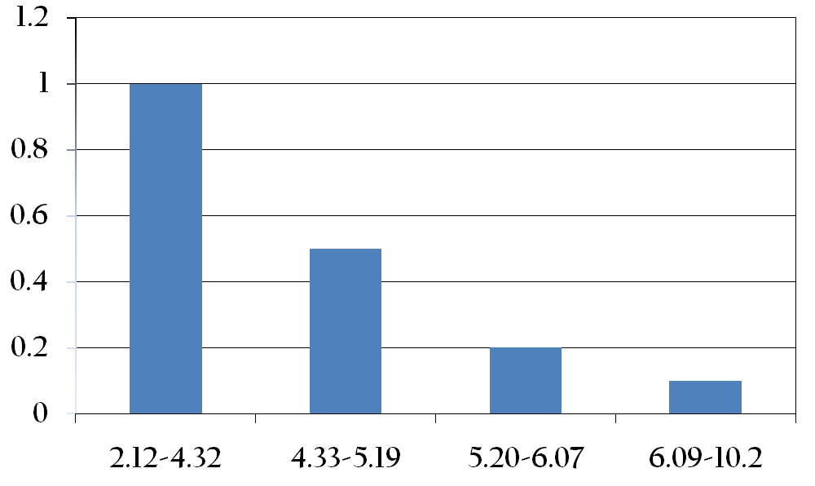
Relative risk of sudden cardiac death (SCD) according to baseline blood levels of omega-3 fatty acids as percentage of total fatty acids.
Relative risk
Omega-3 fatty acid level (%)
(J Am Coll Card 2009;54:585-594 (Data from Albert et al. originally printed Lee et al.))
Notes:
This slide shows the results of a study that the risk of sudden cardiac death decreases as percentage of serum Omega-3 increases.

Slide 8
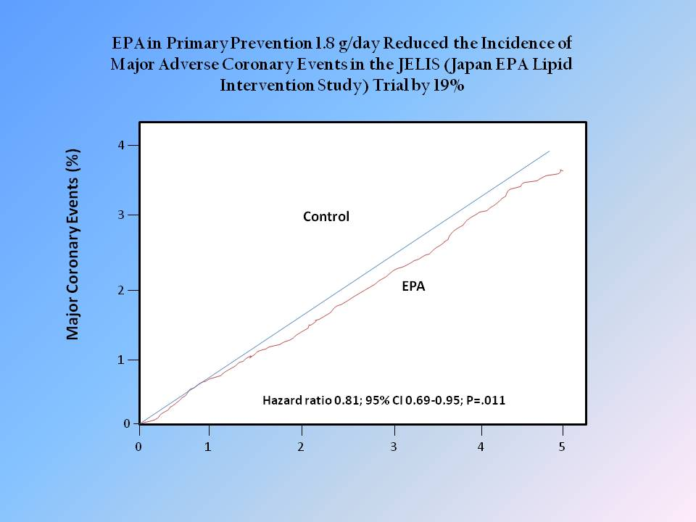
Notes:
Examples of the results from some of the major studies: Primary Prevention - Japanese study 1800 mg/d associated with a 19% reduction in CV disease primary prevention in individuals without prior documented heart disease.
9000 treatment (statin +fish oil) vs. 9000 control (Statin) -2007

Slide 9
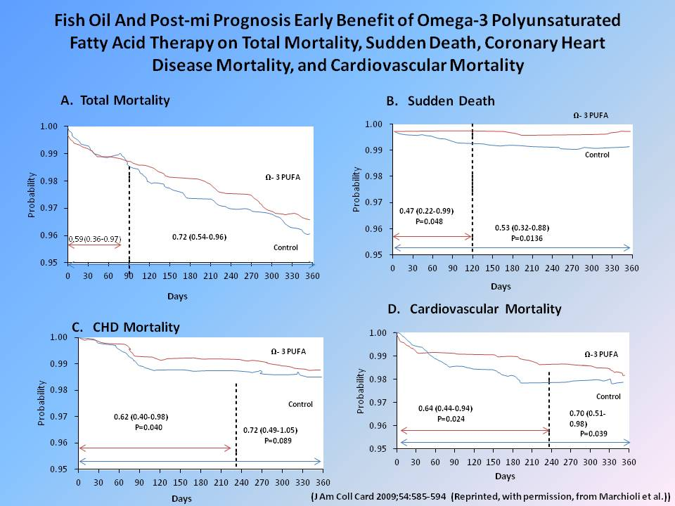
Notes:
Four graphs of results of post myocardial infarction studies showing, clockwise, decreased total mortality, decreased sudden death, decreased coronary heart disease mortality and decreased cardiovascular mortality.
11,000 post MI patients 850mg EPA/DHA 1.2/1.0 ratio -2002

Slide 10
Fish Oil Dosing and Cardiovascular Impact
Dietary doses | Supplemental doses
Clinical effect | Time course to alter clinical events
Antiarrhythmia Triglyceride lowering Heart rate lowering BP lowering Antithrombosis | Weeks Months to years Months Months to years Weeks
Relative strength of effect
0
500
1000
1500
2000
2500
EPA + DHA intake (mg/d)
(J Am Coll Card 2009;54:585-594 (Reprinted, with permission, from Mozaffarian and Rimm))
Notes:
This slide summarizes the studies showing doses and time related to the benefits of fish oil supplements. Threshold of an effect except for lowering triglycerides is 500 – 1000 mg/d.
Nausea, GI upset, fishy belch

Slide 11
Omega~3 Fatty Acids and Secondary Prevention of Cardiovascular Disease-
Is it Just a Fish Tale?
Meta Analysis of Randomized Double-Blind Placebo-Controlled Trials 14 Studies supplemental Omega~3 Fatty Acids
Archives Internal Med 2012; 172:694-696
More recent studies- no effect Omega~3
More cardio protective Tx: Statin use 85-94%
vs. 23-29%
Maybe only effective primary prevention
Questioned exclusion 2 key Positive Studies
Notes:
Title of a recent editorial about a negative meta analysis . Reason for negative study Statin use increased, maybe not effective in secondary prevention, exclusion of 2 positive studies

Slide 12
n-3 Fatty Acids and Cardiovascular Outcomes in Patients with Dysglycemia
Diabetes or high risk diabetes & increased Risk CV events, n=12,536
(NEJM 2012; 367:309-317)
No Protective Effect - Death
n-3 Fatty Acids and Cardiovascular Events after Myocardial Infarction
S/P MI, n= 4,837 (NEJM 2010;363:2015-2026)
No Protective Effect –Death and CV Events
Possible Reasons for Negative Results
  Positive studies <3 months s/p MI
  More cardio protective therapy in current studies
  Not effective in diabetes or those increased risk diabetes
Notes:
Additional recent studies showing no effect . Another negative study in 5/9/2013 NEJM randomized control trial of capsule fish oil vs placebo capsule of olive oil among 12,513 patients at increased risk for CV disease

Slide 13
Summary of Cardiovascular Benefits of Ingesting Fish/Fish Oil
Primary Prevention
19% Reduction in CV Events (0.5 gm/day)
S/P MI
23% Reduction (0.5 gm/day)
Arrhythmias
30% Reduction Risk of Atrial FIB (0.5 gm/day)
CHF
5-10% Reduction Mortality (0.5 gm/day)
Triglycerides
30-40% Reduction (FDA Approved 4gm/day)
Notes:
This slide summarizes benefits based on positive studies. Two 6 oz. servings/week are equivalent to 500 – 1000 mg fish oil/day. All cardiovascular benefits occur at 500-1000 mg/day except for lowering high triglycerides where dosage is 4000 mg/day.

Slide 14
Cognitive Decline and Dementia
Randomized/Control studies - negative
both in cognitively normal and those with
dementia
Brit J Nutrition 2012
Cochrane Data Base System Review 2012
Notes:
Higher dietary intake and blood levels of DHA and EPA associated with reduced risk of dementia. Mechanistic studies that show change in gene expression that influence inflammation. However, RCT studies are negative

Slide 15
Childhood Cognitive &Visual Development
DHA Accumulates Second Half ofPregnancy
Neural Cortex & Retinal Membrane Synopses
Observational Studies - Positive Association
High-Grade Stereoacuity
Vocabulary Comprehension
Receptive Vocabulary
Verbal Intelligence Quotient
Higher Cognitive Scores
Notes:
Basis for why omega 3 thought to be beneficial to fetal development; 1) accumulation in neural tissue and 2) studies showing that pregnant women who ate more oily fish, their children had these positive effects on their development

Slide 16
Gestational Benefits
Benefits to Mother
Reduce Pre-Eclampsia - 7.5 fold decease
Reduce Incidence Pre term delivery - 1.9% vs. 7.1%
Reduce Post-Partum Depression
Benefits to Child
Reduction allergic disease
Improved eye and hand coordination
Enhanced cognitive and behavioral function
Improved sleep behavior
Decreased risk of Type 1 diabetes
Decreased risk cerebral palsy
Improved IQ at 4 years of age
(Genuis SJ. Reproductive Toxicology 2008; 28: 81-85)
Notes:
This slide summarizes gestational benefits. Unlike the CV benefits where there are multiple studies for the different outcomes, these purported benefits are generally based on single studies. Since children and women of child bearing age are considered the high risk group for pollutants a number of these gestational benefits are in direct conflict with the potential toxicity of contaminants (i.e. adverse neurologic effects of mercury vs. beneficial effects on hand/eye coordination of fish ingestion).

Slide 17
Randomized Controlled Trial of
Fish Oil Supplementation
in Pregnancy on Childhood allergies
Allergy 2013; 68: 1370-1376
Randomized Control Trial - Atopic pregnant women,
368 received 900 mg omega3 capsule and
368 received vegetable oil capsule from 21 weeks
of gestation until birth.
No reduction in IgE associated allergic disease
in first 3 years of child’ life
Notes:
Unlike cardiovascular disease randomized clinical trials have been negative for benefits in pregnant women/offspring

Slide 18
Systemic Review & Meta Analysis
Am J Clinical Nutrition 2013; 97: 531-544
Eleven Randomized Control Studies
Reduce Developmental Delay but no effect on mean
Developmental Standard Score at 18 months
Motor & Language Development
Visual Development
“Does not support or refute”
Notes:
Meta analysis of randomized control trials for omega 3 supplements during pregnancy reached the conclusion cannot neither ”support or refute” that supplementation in pregnancy improves cognitive or visual development.
Best evidence for positive effect was on reducing developmental delay although no effect on mean developmental standard Score at 18 months

Slide 19
A Quantitative Assessment of the Net Effects on Fetal Neurodevelopment from Eating Commercial Fish
(As Measured by IQ and also by Early Age
Verbal Development in Children)
May 2014
Overall
Average Neurodevelopment benefit
0.7 IQ points (95% CI 0.39-1.37)
Sensitive End Point
Average Verbal IQ points 1.41 (95% CI 0.91-2.00)
Maximum Improvement – 3 IQ points if all pregnant
women average 12 ounces/week
http://www.fda.gov/Food/FoodborneIllnessContaminants/Metals/ucm393211.htm
Notes:
From Executive summary of the quantitative assessment done by FDA in support of updated recommendation on fish ingestion during pregnancy.

Slide 20
ACOG Practice Advisory: Seafood
Consumption during Pregnancy
June 10, 2014
“ACOG encourages women to follow the updated FDA recommendations that pregnant women, women who might become pregnant, and breastfeeding mothers should eat at least 8 and up to 12 ounces per week of a variety of fish lower in mercury.”
Notes:
Policy statement from ACOG on supporting FDA guidelines published June 11, 2014 Federal Register

Slide 21

Objectives
Benefits of Eating Fish/Fish oil
Risks of Eating Fish/Fish oil
Store Bought vs. Recreational Caught Fish
Talking to Patients
Available Resources
Notes:
Having talked about the benefits, next set of slides will address the risks.

Slide 22
Mercury Poisoning
Episodes & Symptoms
Minamata, Japan, 1943-1961
Ingestion of fish from bay with mercury pollution
Iraq, 1961 & 1971
Ingestion of mercury fungicide contaminated grain
Adults
Ataxia, memory loss, paresthesias, blurred vision and hearing loss
Children
Mental retardation, cerebral palsy, deafness blindness and dysarthria after exposure in utero
0.1 µg/kg-day (EPA 2005)
Notes:
Two major types of contaminants in fish: 1) mercury; and 2) fat soluble persistent chemicals such as PCBs.
Concern about mercury comes from acute poisoning episodes and studies of populations that regularly eat large amounts of fish.
Acute Poisonings:
A factory in Japan that discharged mercury into water and mercury accumulated in fish that were eaten.
Two episodes in Iraq where grain treated with a mercury fungicide that was intended for use as seed was instead eaten.
Studies of both episodes find neurologic changes. The calculated upper limit of safe ingestion of mercury/day from studies of both populations was 0.1 µg/kg-day.

Slide 23



Studies of Fish Eating Populations
Seychelles
Faroe Islands
New Zealand
Decreased Performance on neuropsychological tests
0.1 µg/kg-day (EPA 2005)
1.0 PPM (FDA)
Notes:
Studies of children from three populations that regularly ingest fish found neurological changes although much less dramatic than those found in the populations on the previous slide with higher levels and acute exposure. From these studies of chronic exposure similar to the calculation from the acute exposure studies the calculated level of safety was 0.1 µg/kg-day. FDA has calculated a concentration level of 1 part per million based on the studies.

Slide 24
Mercury, Fish Oils and Risk of Acute Coronary Events and Cardiovascular Disease, Coronary Heart Disease, and All Cause Mortality in Men in Eastern Finland with Hair Mercury >2.03µg/g
 | OR | 95% CI
Acute Coronary Event | 1.6 | 1.2-2.1
CVD | 1.7 | 1.2-2.4
CHD | 1.6 | 0.99-2.5
Death Any Cause | 1.4 | 1.2-1.7
(Arterioscler Thromb Vasc Biol 2005; 25:228-233)
Notes:
In addition to the adverse neurological effects in children, some studies have found an increased risk of heart disease associated with mercury exposure. This slide shows the results of a study of Finnish men where mercury hair levels, a measure of longer term mercury exposure than blood, was associated with heart disease. However, a well done study published in March 2011 in the NEJM found no association between mercury levels, measured as mercury in the toe nail clippings and heart disease in either men or women.

Slide 25
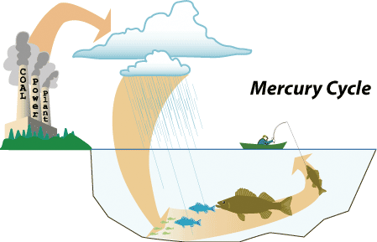
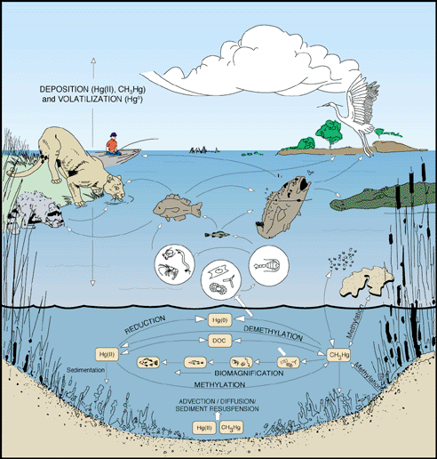

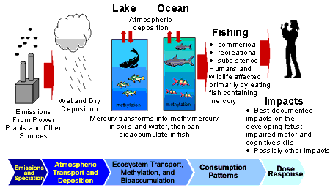
Notes:
This slide shows how mercury gets into fish. Burning coal, releases mercury out the smoke stacks, which is carried in atmosphere, deposited in water as inorganic mercury, methylated and changed to organic mercury, bioaccumulated up food chain and then ingested.

Slide 26
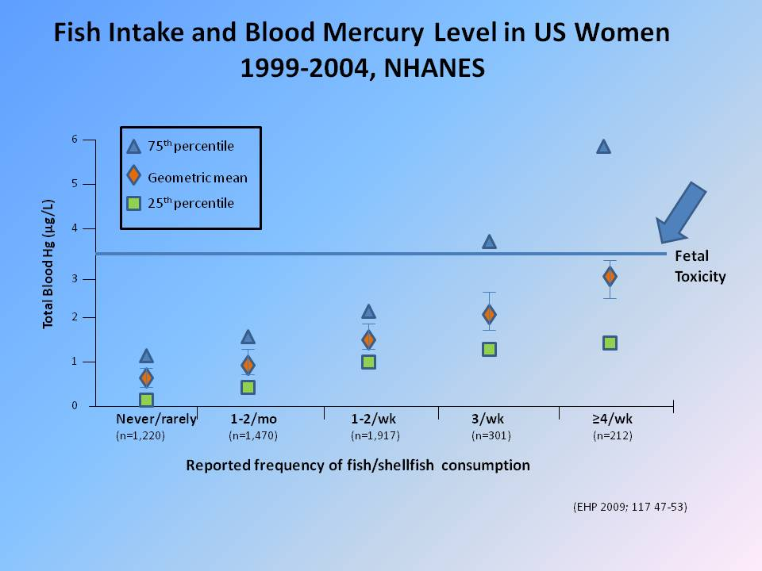
Notes:
This slide shows the correlation between the number of fish ingested per week and blood mercury level from a random sample of the US population. The blue line marks the lowest blood mercury level associated with toxicity to the fetus. At 3 servings per week, 75% of women are above the toxic level and at 4 servings per week approximately half of women above the toxic level.

Slide 27
Summary of Trends in Blood Methyl Mercury (MeHg) and Fish Consumption, Women
Aged 16-49 years, NHANES 1999-2010
NHANES Survey Years | Blood MeHg Mean µg/L(95%CI) | Fish eaten in 30 days Mean gms (95% CI) | Blood MeHg for women who ate fish 0 times in 30 days Mean µg/L (95% CI) | Blood MeHg for women who ate fish 6+ times in 30 days Mean µg/L (95% CI)
1999-2000 2001-2002 2003-2004 2005-2006 2007-2008 2009-2010 | 0.94 (0.74,1.19) 0.71 (0.57,0.90) 0.56 (0.40,0.78) 0.60 (0.44,0.82) 0.55 (0.40,0.75) 0.69 (0.56,0.86) | 255 (213, 296) 311 (275, 346) 270 (235, 305) 323 (277, 368) 259 (229, 290) 309 (269, 348) | 0.61 (0.50,0.72) 0.43 (0.33,0.54) 0.38 (0.27,0.50) 0.37 (0.25,0.48) 0.36 (0.25,0.47) 0.50 (0.40,0.60) | 3.36 (2.76,3.97) 2.34 (1.92,2.75) 2.07 (1.68,2.46) 1.84 (1.61,2.08) 1.95 (1.54,2.37) 2.11 (1.87,2.35)
(Adapted from EPA-823-R-13-002, July 2013)
Notes:
This slide shows average blood mercury levels in women in the US by two year periods from 1999 through 2010. Fish consumption in past 30 days has stayed fairly constant while mercury levels are lower than during the 1999-2000 time period and were trending downward except for the most recent 2009-2010 time period.

Slide 28
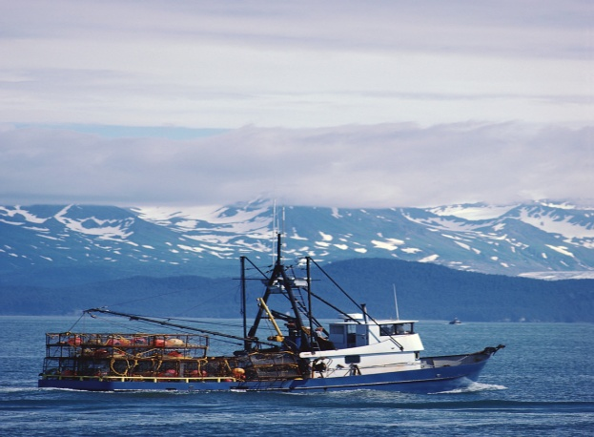
Store Bought Fish with the Highest Levels of Mercury (about 1 ppm)
 | Omega-3 fatty acids (grams per 3-oz. serving) | Mean mercury level in parts per million (ppm)
Tilefish (golden bass or golden snapper) | 0.90 | 1.45
Shark | 0.83 | 0.99
Swordfish | 0.97 | 0.97
King mackerel | 0.36 | 0.73
Notes:
This slide shows the fish with the highest mercury levels and grams of Omega-3 per 3 ounce serving. So for example, even though swordfish is an oily fish, it has a high concentration of mercury.

Slide 29
Omega-3 and Mercury Levels of
Top 10 Fish and Shellfish in the United States
Based on Consumption
 | Omega-3 Fatty Acids (grams per 3-oz. serving) | Mean Mercury Level in Parts per Million (ppm)
Canned Tuna (light) | 0.17–0.24 | 0.12
Shrimp | 0.29 | ND*
Pollack | 0.45 | 0.06
Salmon (fresh, frozen) | 1.1–1.9 | 0.01
Cod | 0.15–0.24 | 0.11
Catfish | 0.22–0.3 | 0.05
Clams | 0.25 | ND*
Flounder or Sole | 0.48 | 0.05
Crabs | 0.27–0.40 | 0.06
Scallops | 0.18–0.34 | 0.05
* ND – mercury concentration below the Level of Detection (LOD=0.01ppm)
Notes:
This slide shows the most common fish and shellfish eaten in the United States. The most common fish eaten have a low concentration of mercury ND - 0 .11 ppm compared to the high mercury concentration fish on the previous slide, 0.73 – 1.45 ppm. But also note that only salmon on this list is considered an oily fish. Salmon has a good risk/benefit ratio between high Omega-3 and low mercury.

Slide 30
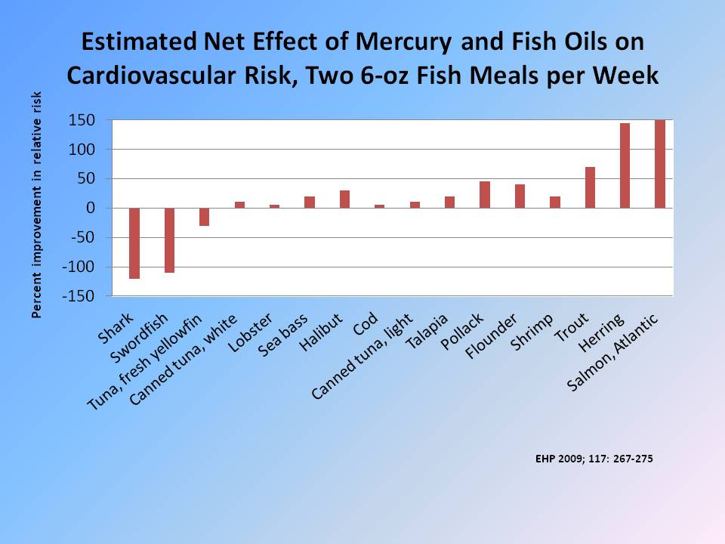
Notes:
This slide compares the risks/benefits of different species of fish based on mercury concentration and grams of Omega-3. Outcome is CV risk which despite the fact that the 2011 NEJM article found no effect on CV risk from mercury the slide is still useful because it is a good visual projection of relative mercury/Omega-3 levels by different species. Discuss farm vs. wild fish shortly but note here that Atlantic salmon are farm raised fish.

Slide 31

Chlorinated Hydrocarbons
FDA Limits
DDT -TDE and DDE
metabolites 5.0 PPM
PCB’s 2.0 PPM
Dioxin 1.0 ppt
Notes:
In addition to mercury, the other contaminants of concern are chlorinated hydrocarbons that are poorly metabolized. Still DDT and metabolites in fish despite being banned decades ago, PCBs and dioxin levels are present but are decreasing because not currently being manufactured. High levels are more localized than mercury. For example, dioxin and Titabawasee River.

Slide 32
Adverse Health Effects of Chlorinated Hydrocarbons
Polychlorinated Biphenyls (PCB’s)
Rice Oil Poisoning – Japan 1968 and Taiwan 1979
Adults - Chloracne
Children – cognitive abnormalities and swollen gums, deformed nails, hyperpigmentation, acne, Decreased IQ when older
Chronic Studies
Michigan and North Carolina Cohorts
Multiple neurocognitive defects in children
Short term memory deficits, Decreased IQ
Decreased muscle tone and activity in infants
Cancer
Dioxin
Anti-estrogen effects
Cancer
Diabetes
Immune suppression
Notes:
This slide summarizes the adverse health effects of chlorinated hydrocarbons. What we know about PCBs is based on two acute poisonings episodes in Japan and Taiwan involving thousands of individuals and lower level exposure among fish eaters in Michigan and North Carolina. Multiple neurologic adverse effects were found. Also concern with an increased risk of cancer based on studies of worker cohorts and animal studies.
For dioxin large number of animal studies and then cohort studies of individuals exposed to dioxin explosion in Sevaso, Italy, soldiers exposed to Agent Orange used during the Vietnam War and workers making Agent orange.

Slide 33
Populations at Increased Risk for Mercury/PCB Toxicity
Children <15
Pregnant women
Women of child-bearing age
Populations at Increased Risk for
Accumulation of Toxins from Fish
Urban subsistence fishers
Certain immigrant populations (e.g., Hmong)
Notes:
Based on the neurologic change seen in epidemiologic studies children are considered the high risk populations. To protect children, pregnant women are also considered high-risk and since these substances accumulate all women of child bearing age are included in the high-risk group. Populations at increased risk for accumulation are urban subsistence fishermen particularly depending on the locale where they fish and certain immigrant groups that eat large amounts of fish.

Slide 34

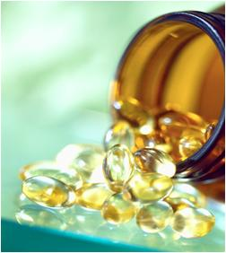
Fish vs. Fish Oil
Fish 340 gm, (Two 6-oz servings per week) | Fish Oil 500-1000 mg EPA & DHA per day
Positive
Benefits in Epi Studies | Benefits in Epi Studies
Other Nutrients Vitamin D Selenium | Absent
Negative
Contaminants Chlorinated hydrocarbons Mercury | Less www.edf.org/page.cfm?tagID=16536
Notes:
What about fish vs. fish oil. Epidemiological studies find equal benefit. It has been hypothesized that whole fish might be better because of the presence of other nutrients in whole fish that are not present in fish oil but no data to confirm or deny this hypothesis. No mercury in fish oil since mercury is in fish flesh. If fish oil purified, can reduce/eliminate chlorinated hydrocarbons. Web site in handout rates different brands of fish oil on removal of chlorinated hydrocarbons.

Slide 35
Life Span and Contaminants of Farmed vs. Wild Fish
Farmed Fish | Wild Fish
Life Span
Atlantic: 1.5-2 years | Pacific: 1-7 years
Concentrations Omega 3/Contaminants
Depends on feed source Omega 3 Chlorinated hydrocarbons Mercury
Notes:
What about farmed vs. wild fish? Farmed fish have a shorter life span than wild fish so less time to accumulate chlorinated hydrocarbons or mercury. Most common farm fish eaten in the U.S. is Salmon. Benefit/risks depend on feed.

Slide 36
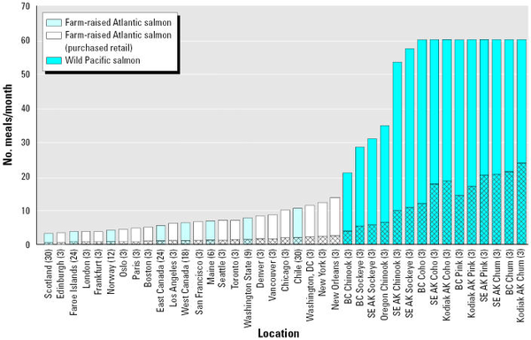
Risk-based Consumption Advice Farm VS. Wild Salmon Based on Dioxin/Dioxin Like Contamination
(EHP 2005; 113: 552-556)
Notes:
This slide shows recommended number of meals/month to limit dioxin and dioxin like compounds in wild vs. farm fish (hatched bars would limit these compounds to even lower levels). For these contaminants in the early 2000’s wild fish lower levels (and therefore increased meals/month) and farm fish from U.S. lower levels than farm raised fish from Europe 60 vs. 10 vs. 2 meals/month, respectively. This slide, however, does not address mercury which based on age of fish alone would be lower in farmed fish.

Slide 37
Objectives
Benefits of Eating Fish/Fish oil
Risks of Eating Fish/Fish oil
Store Bought vs. Recreational Caught Fish
Talking to Patients
Available Resources
Notes:
Although most people obtain their fish from the supermarket, ~ 10% of our population is catching and eating Great Lakes fish.

Slide 38
Michigan Fish
Bass – Large, Rock, Small Mouth Bluegill Black Buffalo Brown Bullhead Carp Catfish, Channel Crappie, Black Freshwater Drum Lake Herring Muskellunge | Perch – White, Yellow Northern Pike Salmon – Chinook, Coho Gizzard Shad Sturgeon Suckers Trout – Brown, Lake, Rainbow Turbot Walleye Lake Whitefish
Notes:
This slide shows the 20 most common types of fish caught in Michigan Watersheds.

Slide 39
Benefits & Risks of
Store/Restaurant vs. Recreational Fish
Store- or Restaurant-Bought Fish | Recreationally-Caught Fish
Benefits
Wider Variety | Able to Select Smaller Fish
Able to Select Oily Fish | Able to Select Fishing Locale
FDA standard for PCBs/Mercury
Risks
Highest Mercury Fish | Possibly Highly Contaminated
Notes:
This slide shows the benefits/risks of store bough vs. recreationally caught fish. Smaller, younger fish will have less contaminants.

Slide 40

Notes:
Five of these brochures by region

Slide 41
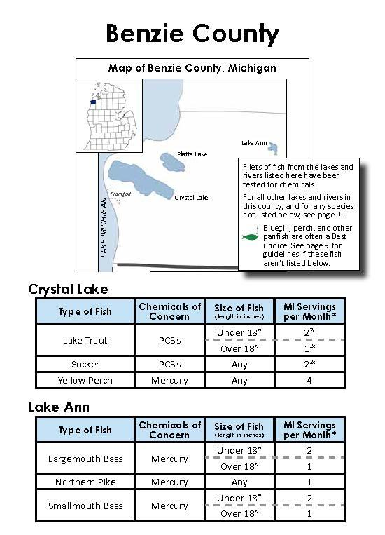
*Can double serving if not mercury, not limited and follow the 3 C’s

Slide 42
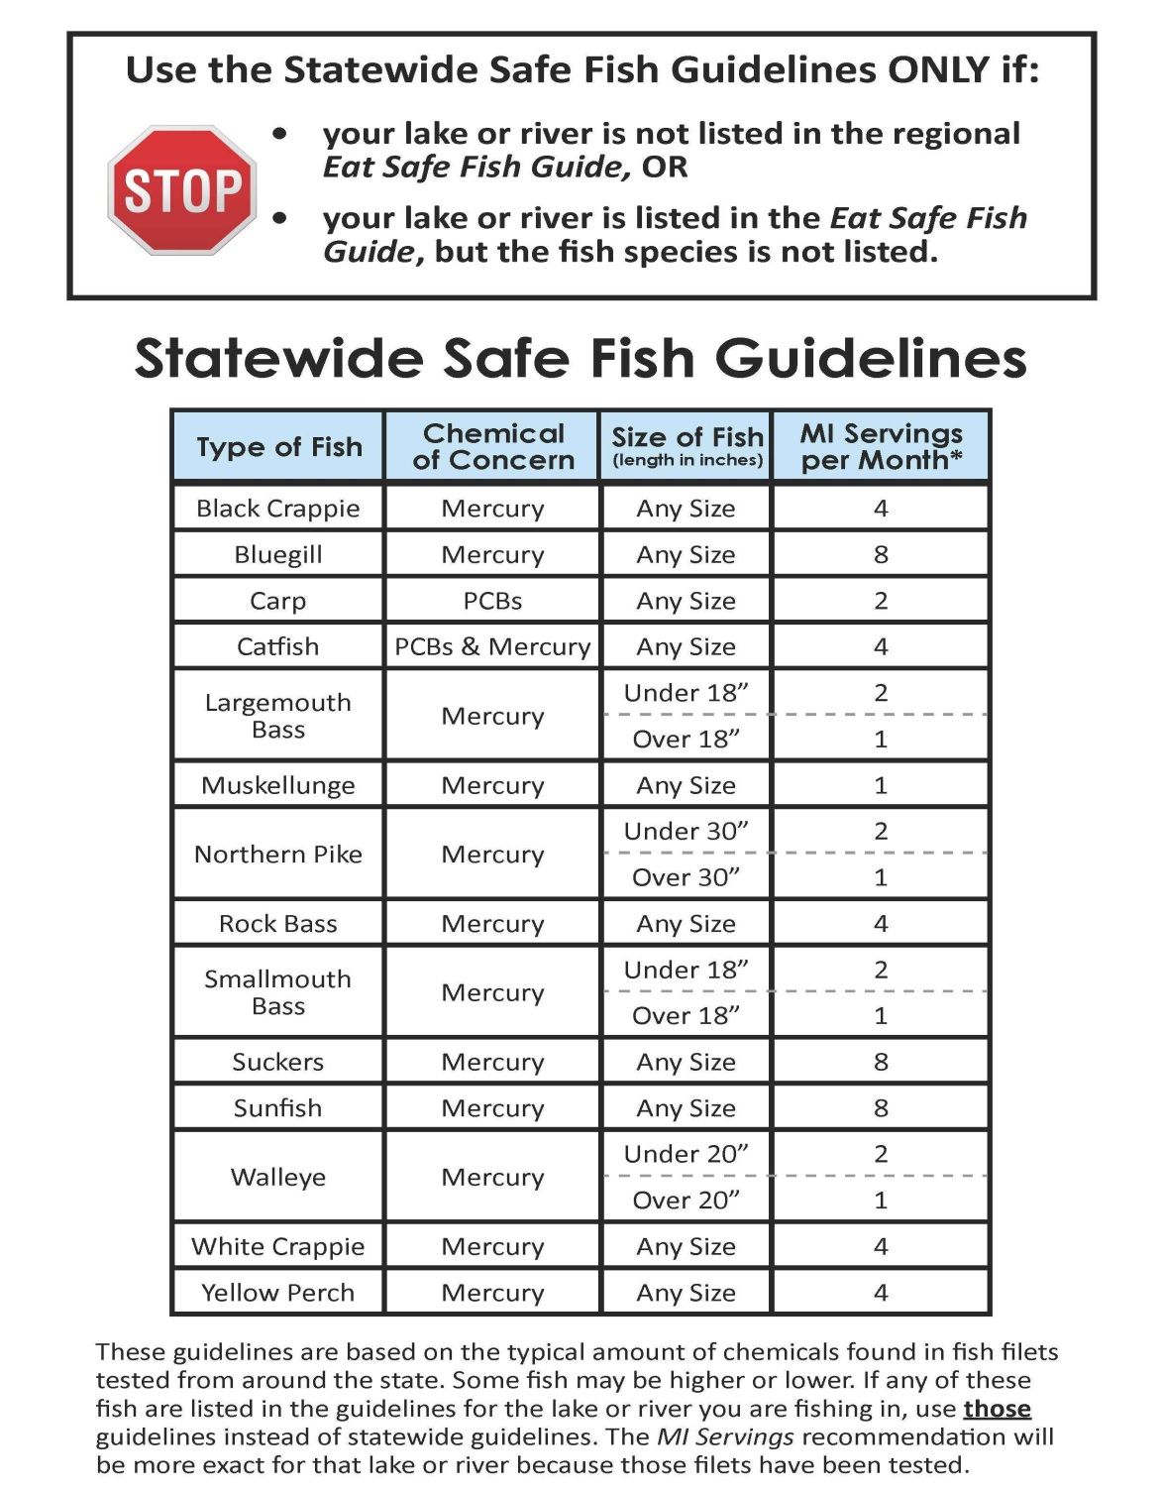
Notes:
For people who fish when specific bodies of water or species of fish are not covered in the guide

Slide 43
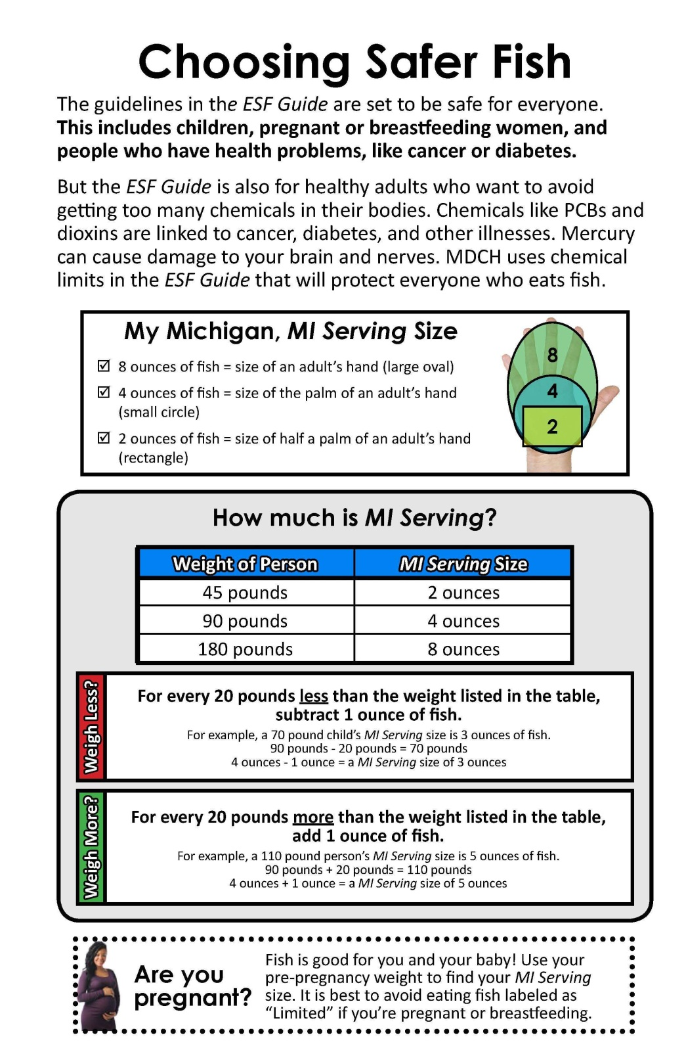
Notes:
Information on health department web site on serving size and variation based on weight

Slide 44

Notes:
Example of handouts on the MDCH web site and at our booth for patients and yourself

Slide 45

Objectives
Benefits of Eating Fish/Fish oil
Risks of Eating Fish/Fish oil
Store Bought vs. Recreational Caught Fish
Talking to Patients
Available Resources
Notes:
How do we translate the information presented into something that can be used clinically?

Slide 46
Awareness of Health Advisories for Consumers of Great Lakes Sport Fish
Great Lakes fish eaten by 8.4% (95 CI 7.6-9.2) of adults
60% (95 CI 53-68) Michigan residents aware of fish advisory
 | OR | 95% CI
Men | 2.3 | 1.5 – 3.4
White | 4.2 | 1.9 – 9.1
College Degree | 3.1 | 1.3 – 7.6
Eating >24 Great Lakes fish meals per year | 2.4 | 1.4 – 4.3
(EHP 1997; 105:1360-1365)
Notes:
In 1997, the Health Department conducted survey of awareness of the annual fish advisory. Awareness was 60%. White males with college degrees who eat and presumably catch more fish were more aware.

Slide 47
Changes in the amount of fish meals consumed during pregnancy compared to before pregnancy based on receiving information about eating fish during pregnancy; MN, PA, WI
Change | Fish consumption during pregnancy
 | Received sport-caught fish info (61.2%) |  | Received purchased fish info (77.2%)
 | No (%) | Yes (%) | No (%) | Yes(%)
Did not eat fish or shellfish before or during pregnancy | 16.4 | 7.0 | 25.3 | 5.4
Ate more | 7.8 | 6.2 | 5.5 | 7.8
Ate the same amount | 30.6 | 28.4 | 31.8 | 28.5
Ate less | 37.9 | 53.1 | 29.7 | 52.7
Stopped eating | 7.3 | 5.3 | 7.7 | 5.6
(Adapted Environ Res 2014; 135:88-94)
Notes:
Mail questionnaire of 3000 women who recently delivered in Minnesota, Pennsylvania and Wisconsin in April 2012 and follow up survey of sample of non respondents (130) and six focus groups.
Response rate 30%, 857 completed mailed survey

Slide 48
Sample Statements & Focus Group Responses
Less Useful
Statement – “If you follow the fish consumption guidelines, you and your baby will get a lot of the health benefits and have very little risk.”
Response - “It’s long, and I kind of get lost in it.”
Useful
Statement – “Fish are the only source of Omega-3 fats, which may be beneficial during fetal brain and eye development.”
Response – “Why should I eat [fish]?.....And I feel like this says, “Well, eating this is good for you because of this.”
(Adapted Environ Res 2014;135:88-94)
Notes:
Example of statements focus groups found useful versus not useful

Slide 49
Populations at Increased Risk for Mercury/PCB Toxicity
Children <15
Pregnant women
Women of child-bearing age
Populations at Increased Risk for
Accumulation of Toxins from Fish
Urban subsistence fishers
Certain immigrant populations (e.g., Hmong)
Notes:
This slide is a reminder who the high risk groups are.

Slide 50
Clinical Activity
Brief Dietary History
www.aafp.org/afp/990315ap/1521.html
Starting the Conversation -AJPM 2011; 40(1):67-71
Encouraging Fish Consumption
3. Advice for Cooking and Fish Selection
MDCH Consumer Guide – Eat Safe Fish
http://www.michigan.gov/mdch/0,1607,7-132-54783_54784_54785_58671-256887--,00.html
Advice on fish selection if patient or member of patient’s family catch and eat fish
http://www.michigan.gov/mdch/0,4612,7-132-54783_54784_54785_58671-296074--,00.html
Notes:
What do you currently do to encourage a healthy diet? Here is suggested activity: 1) Brief 2-3 minute dietary histories available at these two sites; 2) encourage fish consumption; 3) general advice for cooking fish; 4) advice on fish selection whether store bought or self caught.

Slide 51
General Principles of Preparing Fish Safely
1. Trimming and Cooking
• Cut off all the fat.
• Remove or poke holes in the fish’s skin before cooking. This will help the fat and
chemicals drain off the fish.
• Bake, broil or grill the fish on a rack. Throw away the drippings.
• Do not eat the guts, head, skin, bones or dark fatty areas.
• Do not re-use the oil that was used to deep or pan fry fish.
2. Eat fish from different places such as the grocery store, restaurants, rivers and lakes.
3. Eat smaller, younger fish. Bigger and older fish have had more time to collect
more chemicals in their bodies.
4. Don't eat fatty fish like carp and catfish from polluted waters. Most chemicals (except
for mercury) collect in the fat. Buy catfish from your grocery store instead.
5. Mercury stays in the filet of the fish and cannot be cut or cooked away. Use the guides
to choose fish that are low in mercury.
Do not eat any of the internal organs of any
fish from any water body (example: liver). (MDCH)
Notes:
Advice on cooking includes most importantly advice to bake, broil or grill and for self caught fish, recommendation on cleaning and selecting smaller fish and for bottom feeders not fishing from polluted waters.

Slide 52
Mercury Reference Values
Specimen | Half-Life | Normal | Allowable Workplace Level | Acute Toxicity
Urine | 40 days | 4µg/L | 50µg/L | >300µg/L
Blood | 1-2 days | A 4.6 µg/L C 1.9 µg/L | 25µg/L | >50µg/L
Notes:
This slide provides reference values for urine and blood mercury. Generally not necessary to order mercury levels but if a patient indicates a heavy ingestion of fish, particularly the high mercury fish, might be helpful to show them the need to reduce this ingestion.

Slide 53
Objectives
Benefits of Eating Fish/Fish oil
Risks of Eating Fish/Fish oil
Store Bought vs. Recreational Caught Fish
Talking to Patients
Available Resources
Notes:
Next I will talk about resources for patients. Also resources for health care providers want more info.

Slide 54
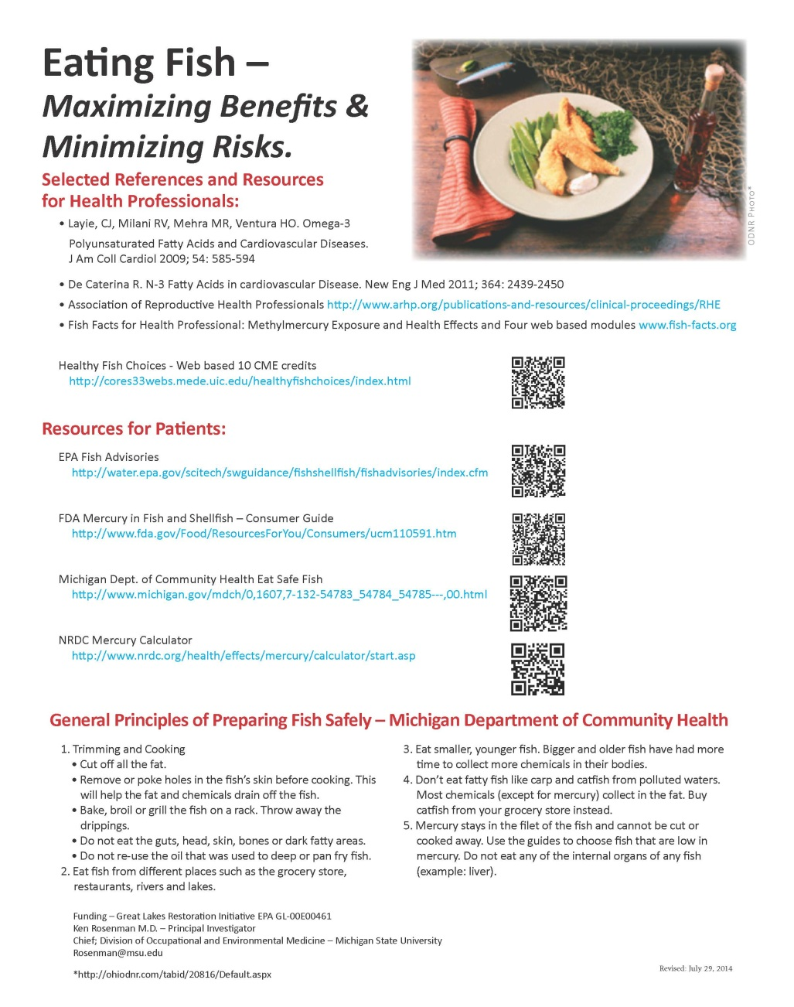
Choosing Fish from Grocery Store/Restaurant
Mercury cannot be removed from fish by trimming and cooking. Use the following information to choose fish and seafood from the grocery store or restaurant.
http://www.oem.msu.edu/userfiles/file/Fish/EatingFishResourcePageSept12.pdf
Notes:
The left part of this slide is a resource sheet available on the MSU website and at our booth. Readings and web sites for you to get more information or take an online CME course. Statement on right summarizes that limiting mercury ingestion comes from fish selection not preparation. Preparation only limits fat soluble chlorinated compounds. Next slide nice practical summary on fish selection.
Resources for Patients. 1) EPA listing of all the state fish advisories, 2) FDA guidelines on mercury, 3) Michigan Department of Community Health guideline for both recreationally caught and store bought fish.

Slide 55
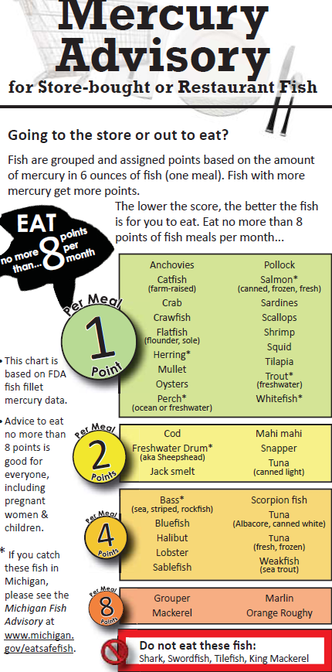
Notes:
This brochure is a nice practical summary for how much and what kind of fish to eat

Slide 56

Summary
To maximize the benefits of fish ingestion avoid certain types of fish.
Children and women of child bearing age, in particular, should avoid/limit ingestion of certain types of fish.
Availability of consumer guides on fish selection and preparation.
Notes:
This slide summarizes the three major points of the presentation

Slide 57
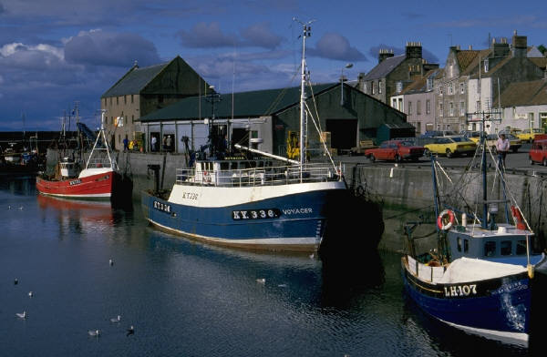
MSU/EPA Fish Group
CHM/Department of Medicine | COM
Gary Ferenchick, M.D. | Kari Hortos, D.O.
Kenneth D. Rosenman, M.D.
CHM/OMERAD
Deborah Sleight, Ph.D.
David Solomon, Ph.D. (Also Dept Med)
Funding - Great Lake Restoration Initiative EPA GL-00E00461
Notes:
Acknowledge MSU/EPA fish group and funding source.

